Slide 1

Ohio High School Athletic Association
Wrestling Weight Management Program
Training for
OHSAA-Certified General Assessors

Slide 2
Becoming and Maintaining Master and
General Assessor Status

Slide 3
Master Assessor
Have at least three years of skinfold assessment experience
Willing to teach other subsequent General Assessors outside of their organization
Can perform original assessments
Can reassess their own athlete if they fail a hydration test
Notes:
As a Master Assessor your responsibilities are to:
a. Teach general assessors within and outside your organization
b. Change original assessment numbers due to an error for themselves OR a General Assessor
c. Assess all athletes if they fail a hydration test
d. All the above

Slide 4
Master Assessor
Willing to be responsible for handling the first step of the appeal process
If Master Assessor does not meet these obligations they relinquish their status of Master Assessor and take on a General Assessor status
TrackWrestling (online weight management program) has different permission level settings for Master and General Assessors

Slide 5
New Master Assessor
Must receive permission from the OHSAA director
Permission is based on distance the athlete has to travel and shortage of Master Assessors in area
Must meet guidelines and provide all responsibilities of a Master Assessor
Must be properly trained by a person the OHSAA designates before Active Status is granted
Notes:
To become a Master Assessor all are true except:
a. Must receive permission from the OHSAA director
b. Once approved you can start immediately
c. Must meet guidelines and provide all responsibilities of a Master Assessor
d. Must be properly trained by a person the OHSAA designates before Active Status is granted

Slide 6
General Assessor
Cannot instruct others in the technique
Can perform the ORIGINAL assessment
Cannot assess a wrestler from a school with which they currently have a professional relationship
Can perform a “redo” assessment if a wrestler failed original hydration test, 48 hours have passed and NOT their own wrestler
Notes:
As a General Assessor you can NOT:
Retest your own athlete if they failed hydration test
Instruct others to become a General Assessor
Change another Assessor’s numbers
Do an appeal
All of the above

Slide 7
General Assessor
Cannot re-test a wrestler if they passed the original assessment.
No authority in appeals and must refer to the local Master Assessor
Cannot change an original wrestling assessor's numbers.
  Double check numbers before you save
  Any changes must be submitted to Tyler Brooks at the OHSAA.
  Copy of Individual Profile will need to be provided to Master Assessor
  Coaches can make name changes and should have roster in computer prior to original test date.
Notes:
As a General Assessor you can NOT:
Retest your own athlete if they failed hydration test
Instruct others to become a General Assessor
Change another Assessor’s numbers
Do an appeal
All of the above

Slide 8
General Assessor
Any report of changing numbers outside of these guidelines will be reported to the ethics committee of the professional’s organization and the OHSAA
Will no longer be qualified to be an Assessor if ethic codes have been violated or if OHSAA has found fault for a minimum of one year and subject to additional penalties and sanctions imposed by the OHSAA Commissioner.
Notes:
As a General Assessor you can NOT:
Retest your own athlete if they failed hydration test
Instruct others to become a General Assessor
Change another Assessor’s numbers
Do an appeal
All of the above

Slide 9
Requirements of a General Assessor
It is considered a “conflict of interest” for an active coach, at any level, to become an OHSAA-approved Master or General Assessor
  Coaches are only allowed to perform clerical and organizational duties during the assessment process
The General Assessor may be subject to a random sample test to substantiate the quality and consistency of his or her measurements
NEW Assessor candidates must submit to a training session of 1 hour classroom instruction and 1 hour of practical training, and an annual educational update as designated by the OHSAA
  Bring Lange Skinfolds and calibration block
  Wear appropriate clothes for skinfold testing

Slide 10
Requirements of a General Assessor
A training fee will be assessed to each General Assessor candidate to attend the training program.
  $35 each, payable to Master Assessor for 3 or more
  $50 each, payable to Master Assessor for 2 individuals
  $100 for an individual training
Assessors will receive access to TrackWrestling upon completion of training
The end date for the New Assessor Training Period is variable from year to year, but will typically end between October 15 and November 1
Notes:
As a Master Assessor you can do all BUT:
Charge a designated fee for training general assessors
Allow chiropractor’s as an eligible person
Require them to bring skin fold calipers, calibration block and wear appropriate clothing for general assessor training
Allow coaches who are involved in wrestling to be a general assessor
True or False: Oct 15 of each school year is the cut off date to become a new or recertified Assessor

Slide 11
Medical Professionals Eligible to Become General Assessor
Physicians
Chiropractor
Registered Nurses
Licensed Practical Nurses
Licensed Athletic Trainers
Licensed Physical Therapists
Registered/Licensed Dietitians and Nutritionist
Exercise Physiologists
BOD POD site personnel—approved by OHSAA
  General Assessor status unless noted

Slide 12
Re-Certification
All Assessors who have been certified the previous wrestling season and wish to recertify must:
  Report any new email address and contact information to:
    Tyler Brooks at tbrooks@ohsaa.org
    Within 30 days of new information
    Failure to notify a change in contact information may forfeit General Assessor status
  Successfully Assess Wrestlers the previous year
    If surpassed a year without assessing you will be considered a NEW General Assessor and need to be retrained
Notes:
To be eligible for the next year you must do all EXCEPT
Have current contact information on file with OHSAA
Successfully assessed wrestlers the previous year
Compete a quiz or review if OHSAA requests
Allow a year or more to lapse on assessing athletes

Slide 13
Re-Certification
  Complete a quiz or review pending on method OHSAA designs.
    Annually or Biannually, pending OHSAA designation
    Must be completed on timeline as prescribed by the OHSAA
    Email will be method of correspondence.
  Pay a recertification fee of $10 or less to OHSAA (as requested)
  Repeat the course after a lapse of certification (more than 1 year) or if the OHSAA determines the need based on declining performance.
  Oct 15th of each calendar year is end date to recertify (subject to change)
Notes:
To be eligible for the next year you must do all EXCEPT
Have current contact information on file with OHSAA
Successfully assessed wrestlers the previous year
Compete a quiz or review if OHSAA requests
Allow a year or more to lapse on assessing athletes

Slide 14
Re-Certification of General Assessor Status
We recommend pairing up with an Assessor and practice skinfold techniques prior to assessing in the upcoming school year.
Compare skinfold numbers obtained
  Goal
    Skinfold numbers average within a mm of each other
    Continue until both assessors skinfold numbers average within these guidelines
Notes:
For a General Assessor to be able to recertify they must be able to:
Perform a complete skin fold assessment
Numbers are within a mm of Master Assessor’s
Have 3 tries to obtain proper numbers
All the above

Slide 15
When Required by OHSAA:
Re-Certification of General Assessor Status
On site - one hour review of wrestling assessor protocols and new guidelines
  Bring Lange skinfold calipers and calibration block
  Wear appropriate clothes for skinfold testing
Perform a complete skinfold assessment and it will be compared to the Master Assessor’s measurements
  Master Assessor will demonstrate skinfold techniques to the group prior to actual testing
  Individual coaching can be obtained upon request
  You will not be qualified to be recertified until numbers are within 1 mm of Master Assessor’s.
  You have 3 tries before you have to sign up for another assessor training.
  You can sign up for one more assessor training course to re-certify
  If failure to pass, you will have to wait until the next year to re-test
Notes:
For a General Assessor to be able to recertify they must be able to:
Perform a complete skin fold assessment
Numbers are within a mm of Master Assessor’s
Have 3 tries to obtain proper numbers
All the above

Slide 16
Testing Procedures

Slide 17
Preparing Athletes for the Test
These instructions should be given to the athletes to be tested in order to maximize the chances of a successful test result.
No vigorous activity the evening before or the morning of the test.
Avoid caffeinated beverages on the day before and day of testing.
On the day of testing, drink 500 ml (17 oz.) of fluid. (A sports drink is an excellent choice.)

Slide 18
Preparing Athletes for the Test
Drink 2-4 cups of water in the 1-2 hour period immediately preceding the test
Be awake 3 hours prior to testing
Do not eat anything 2 hours prior to testing
Avoid vitamin or mineral supplements 2 days before and the day of testing
Appropriate Attire During The Assessment
  Hydration: athletic clothing (shorts, t-shirts, etc.) is acceptable
  Weighing the Athlete: We shall use the same requirements that the NFHS uses for weigh-ins” ”Any contestant shall weigh in wearing a suitable undergarment that completely covers the buttocks and the groin area. Female contestants must also wear a suitable undergarment that covers their breasts.”
Each wrestler needs to complete the Individual Profile Form prior to arrival, so as to prevent misspellings on name and school.
Notes:
True or False
A 1lb weight allowance is permitted for clothing when assessing a wrestler

Slide 19
Preparing Athletes for the Test
Appropriate Attire During The Assessment
  Hydration: athletic clothing (shorts, t-shirts, etc.) is acceptable
  Weighing the Athlete: We shall use the same requirements that the NFHS uses for weigh-ins:
    ”Any contestant shall weigh in wearing a suitable undergarment that completely covers the buttocks and the groin area. Female contestants must also wear a suitable undergarment that covers their breasts.”
  Skinfold Measurements: From the waist down the athlete may wear whatever they would like. All 3 sites will need to be accessible on the upper body.
Each wrestler needs to complete the Individual Profile Form prior to arrival, so as to prevent misspellings on name and school.
Notes:
True or False
A 1lb weight allowance is permitted for clothing when assessing a wrestler

Slide 20
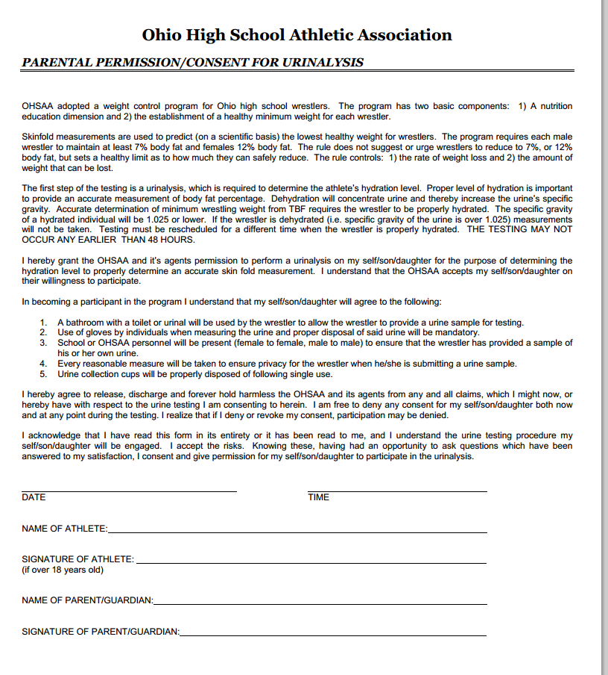
Preparing Athletes for the Test
Wrestler must have parental consent form completed by parent / legal guardian prior to being tested.

Slide 21
Material Needs
It is the responsibility of each assessor to coordinate with the assessment site to make sure the following are available:
  A minimum of two schools/teams must be present for the assessment.
  Exception is a Master Assessor can test a single athlete/team
  Provide enough staff to assist with the recording of data
  Person to perform specific gravity urinalysis
  Provide urine dipsticks to determine urine specific gravity
  Reagent strips average about $50.00 for a package of 100.
  Provide collection cups for urine
  Provide nonsterile disposable gloves

Slide 22
Assessment Setting Restrictions
A General Assessor may NOT perform assessments on a team/individuals which he/she:
  A) Has a professional relationship
  B) Has a sports medicine contract
  C) Provides regular medical assistance
  D) Is assigned regular on-site athletic training coverage
An team/individuals that fit one or more of the described scenarios above are not eligible to be assessed by the described General Assessor

Slide 23
Assessment Setting Restrictions
Any team/individuals that fit one or more of the described scenarios above will be referred to henceforth as “your/their team”.
Generals Assessors:
  A) May NOT conduct any part of the hydration testing for their team
  B) May NOT administer skinfold measurements for their team
  C) May NOT input data into TrackWrestling for their team
  D) MAY record data on the paper Assessment Form for another assessor’s measurements

Slide 24
Assessment Setting Restrictions
Data Entry
  The assessor who conducts either the hydration testing or skinfold measurements must enter that data into their personal TrackWrestling account.

Slide 25
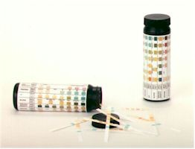
Urine Test Dipsticks

Slide 26
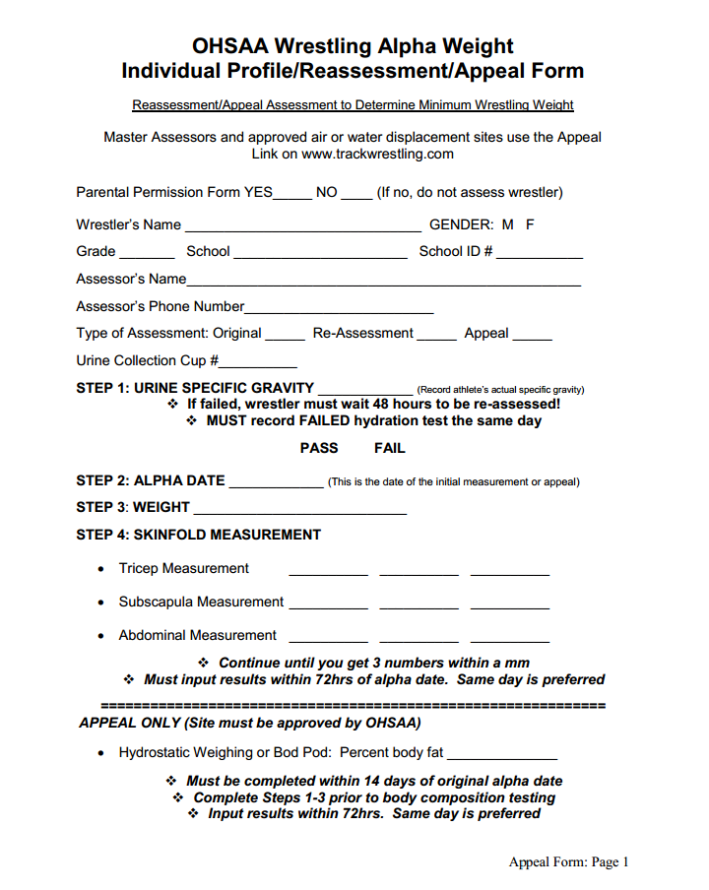
Responsibility of Assessment Site
Provide the Individual Profile Forms to the wrestlers
  It is preferable that the wrestlers fill bring this form to the assessment already completed.

Slide 27
Responsibility of Assessment Site
Must use digital weight scale
  Do not use a dial scale
  Record to the tenth using standard rounding procedures
Skinfold Calipers
  Lange skinfold calipers are the only approved calipers
  Have a calibration block for the Lange skinfold calipers
Notes:
True or False: It is required to used a digital weight scale for testing.

Slide 28
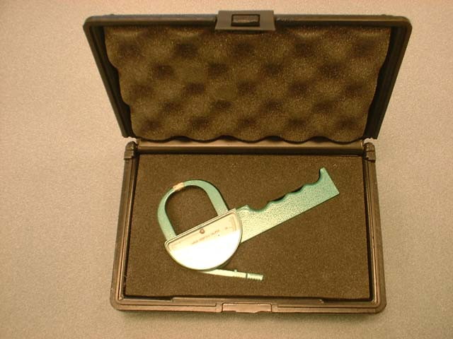
Lange Skinfold Calipers

Slide 29
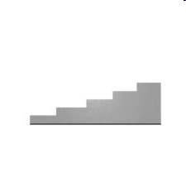
Calibration Block

Slide 30
Step #1 Assessment
Parent Permission form completed
Individual Profile form provided
All assessments are completed in pen
Have copies of forms on file if applicable
Keep all paper work on file for one full year
A faxed or copy of individual profile form from the original General Assessor to the Master Assessor for changes or if requested
Master Assessor will confirm original numbers and dates coincide with TrackWrestling online assessment numbers
Notes:
For an athlete to appeal they need all EXCEPT;
No paper work, just show up
Parent permission form completed
Original individual profile form
Original assessor’s name and contact number

Slide 31
Step #2 Assessment of Hydration Status
Assessor must wear rubber gloves during the assessment
Subject is provided a cup with a written number on it with your discretion
Hydration testing must be done immediately prior to and at the same site where the body composition testing occurs.
All of these terms apply to BOD POD assessments as well
If wrestler fails hydration, a minimum of 48 hours must pass before retesting of hydration status
ALL FAILED ATTEMPTS MUST BE ENTERED INTO THE TRACKWRESTLING WEBSITE IMMEDIATELY
Notes:
When should you record a failed hydration test?
72 hrs
48 hrs
Same day
No recording is necessary

Slide 32
Step #2 Assessment of Hydration Status
Subject is then instructed to provide a 2-3 oz. urine sample (mid-stream) in the privacy of urinal/bathroom.
Recommendation: place a picture or graphic above the urinal to demonstrate that the cup does not need to be full.
Practice and enforce secure procedures during urine collection
Personnel must supervise collection
Reasonable supervision does not mean witnessing the sample going from the body to the cup.
Athlete immediately provides urine sample for evaluation prior to hand washing

Slide 33
Step #2 Assessment of Hydration Status
Practice and enforce secure procedures during urine collection
  Personnel must supervise collection
    Reasonable supervision does not mean witnessing the sample going from the body to the cup.
    Athlete immediately provides urine sample for evaluation prior to hand washing
  Supervise all water faucets in sample area and turn off others in area if needed– wrestlers should not have access to faucets to dilute their sample
  Blue, green, or red dye may be added to toilet to avoid temptation of wrestler dipping cup into toilet water.
Notes:
Hydration status assessment
Athlete provides urine sample for evaluation prior to washing hands
Only 1-3 wrestlers are to be in testing area at one time
Urine temperature should be warm
Can use a reagent strip of choice
All the above

Slide 34
Step #2 Assessment of Hydration Status
Secure Procedures:
  Personnel should be in all traffic areas between collection site and testing site.
    Minimize other traffic between sites to reduce chance of spills.
  ONLY 1-3 wrestlers can be supervised at a time
  Any problems with collection necessitates the provision of another, more secure sample
Notes:
True or False Only have 1-3 wrestlers being assessed for hydration at one time.

Slide 35
Step #2 Assessment of Hydration Status
Secure Procedures, continued:
  Mark each cup with the athlete’s collection number that corresponds to the number on the Individual Profile Form.
  Each wrestler should enter urinal one at a time with only the cup.
  Instruct wrestler to urinate a little into the toilet first to clear urethral contaminants
  Then in cup, collect 1-2 ounces of urine, then finish in toilet

Slide 36
Step #2 Assessment of Hydration Status
Secure Procedures, continued:
  Allow reasonable time for collection
  Once completed Athlete immediately provides sample to the proper authority prior to hand washing
  Appropriate personnel should ensure that the urine is warm by feeling outside of the cup.
    If urine is suspect or cold, reject sample and require wrestler to provide another sample under closer supervision

Slide 37
Step #2 Assessment of Hydration Status
Urine specific gravity is then measured by the reagent strips.
  Follow manufacturer's guidelines
  Bayer Multistick, Chemstrips and Uridynamics are possible options.
1.025 and under is passing.
Upon successful completion of the hydration test the assessor will record the data and the wrestler is then permitted to have his/her body weight and body composition measured.

Slide 38

Trackwrestling - www.trackwrestling.com

Slide 39
TrackWrestling – Login Procedure
Please note: There are many routes to login to your profile. The route does not matter because your profile is only setup for use in the OHSAA Wrestling Weight Management Program.

Slide 40
Logging Into Your Profile: Click on “OPC”

Slide 41
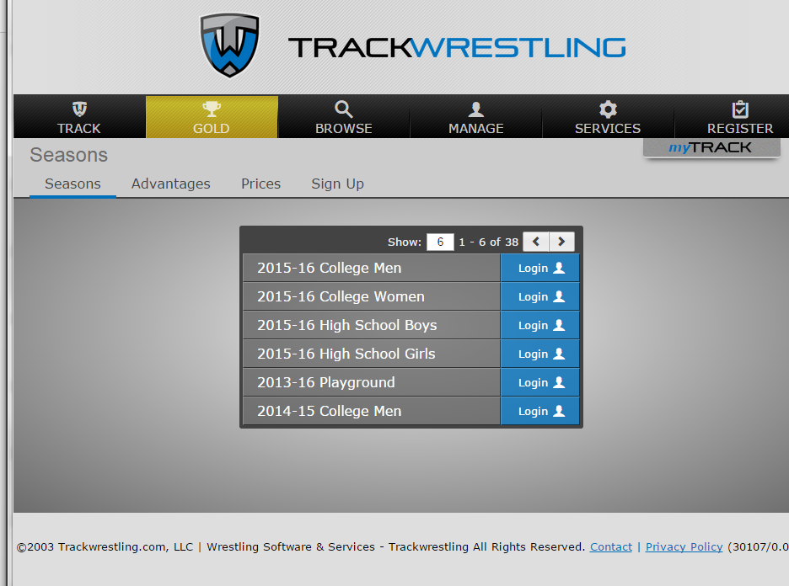
Click on “Login” next to “15-16 High School Boys”, including entering assessments for females

Slide 42
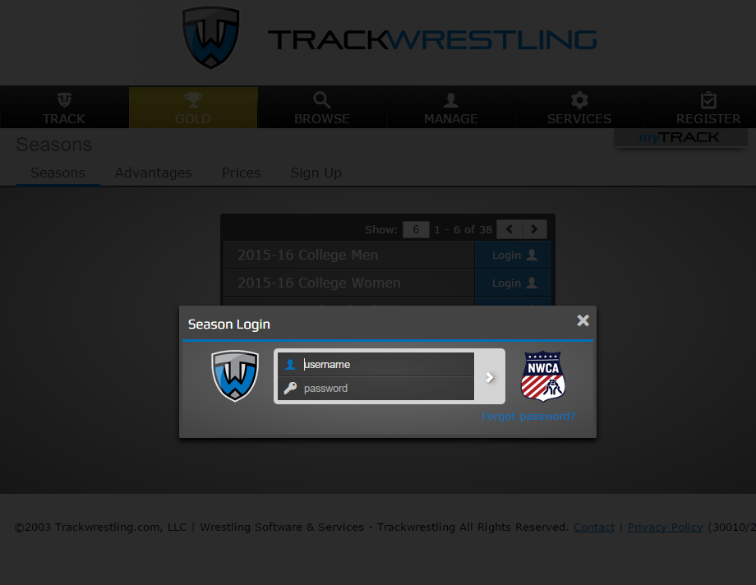
In the “Season Login” box, input your username and password, then click the right-facing arrow.
Notes:
Each Assessor will be provided an ID and password via email from the OHSAA upon completion and registration of your training course
Do not share this with anyone!
Do not use another person’s ID at any time.

Slide 43
Step #3 Assessment of Body Composition: Percent Body Fat
The method of body composition analysis to be used in Ohio is skinfold analysis.
All personnel conducting the body composition assessment need to have advanced training and education in skinfold analysis.
The average cost of a skinfold caliper is around $150.00-$200.00.

Slide 44
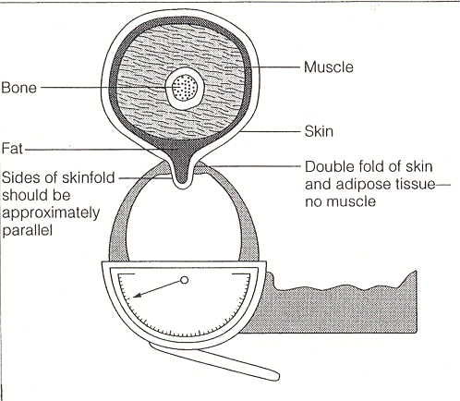
Skinfold Calipers
As shown, the goal is to measure a double fold of skin and subcutaneous tissue (with sides of skinfold approximately parallel).
The thicker the fat layer, the wider the fold.

Slide 45
Protocol for Taking Skinfolds
Take skinfold measurements on the right side of the body (most skinfold equations were developed from measurements on the right side).
Do not take measurements when the subject's skin is moist (ensure that the skin is dry, and has no lotion). Also do not take measurements immediately after exercise.
To reduce error during the learning phase, skinfold sites should be precisely determined, marked, and verified by a trained instructor. The largest source of error in skinfold testing is inaccurate site selection.

Slide 46
Skinfold Protocol (continued)
Firmly grasp the skinfold with the thumb and index finger of the left hand, and pull away.
Hold the caliper in the right hand, perpendicular to the skinfold and with the skinfold dial facing up and easily readable. Place the caliper heads ¼-½ inch away from the fingers holding the skinfold. Try to visualize where a true double-fold of skin thickness is, and place the caliper heads there.
Read the caliper dial to the nearest 1 millimeter within 4 seconds. During the measurement, ensure that the left thumb and forefinger maintains the shape of the skinfold.
Take a minimum of 3 measurements at each site (at least 15 seconds apart).
Continue to measure each site until you get three numbers within a mm
Notes:
Skinfold protocols
a. Males: triceps, subscapular and abdomen are measured
b. Continue to measure each site until you get three numbers within a mm
c. Females: triceps and subscapular are measured
d. All of the above

Slide 47
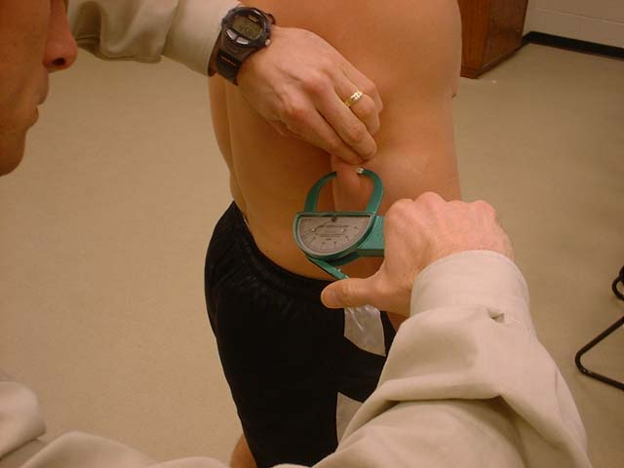
Triceps Skinfold
Vertical fold on posterior aspect of arm, midway between lateral projection of acromion process and inferior margin of olecranon process.

Slide 48
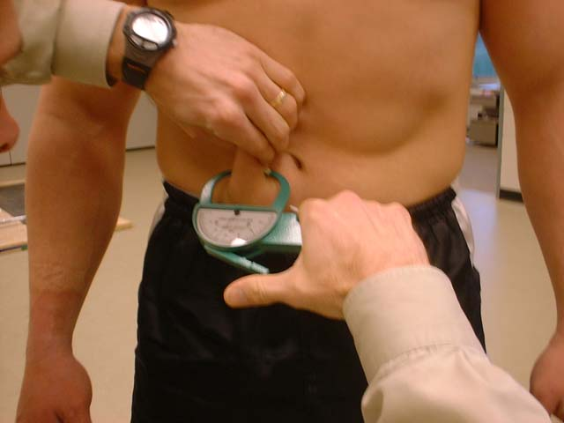
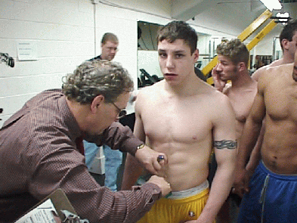
Abdomen Skinfold Site
Vertical fold, one inch to the right side of and ½ inch below the navel.
The Jackson-Pollock procedure uses a vertical fold 2cm to the right of the umbilicus.

Slide 49
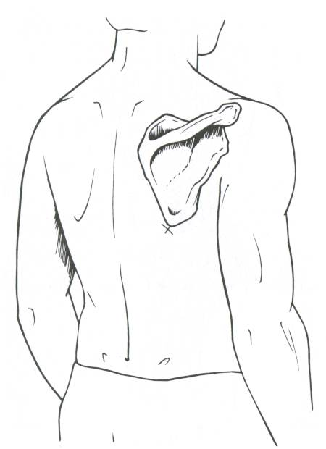
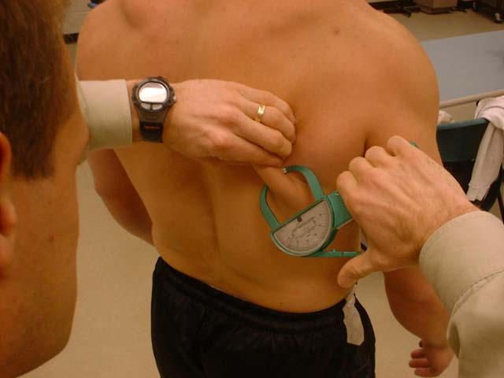
Subscapular Skinfold
Diagonal fold just below the inferior angle of scapula.

Slide 50
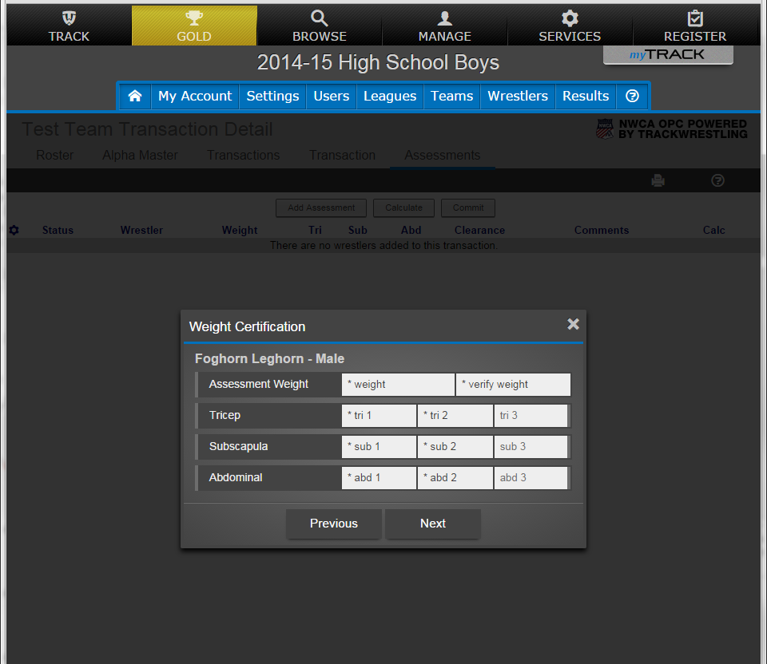
Initial Assessment – Input Measurements

Slide 51
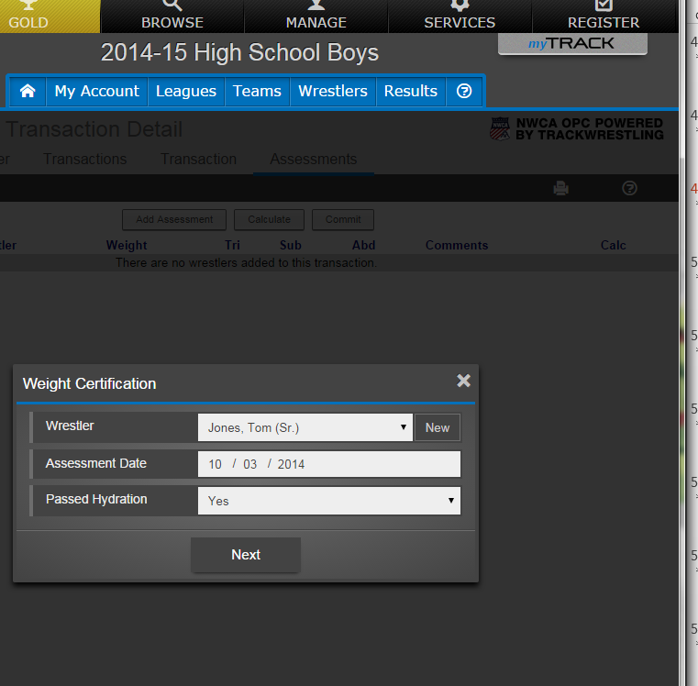
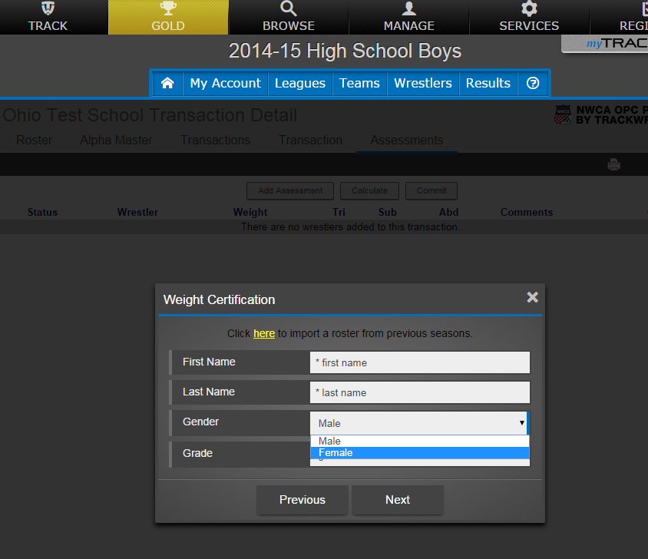
For Female wrestlers:
Click on the “New” wrestler link of the initial assessment page,
Make sure you select “Female” in the “Gender” drop down menu
Only the triceps and subscapular skinfolds will be entered.
Minimal wrestling weight will be calculated at 12%.

Slide 52
Data Input

Slide 53
Inputting the Data on Trackwrestling
If they failed hydration test you must enter it within the same day. (Preferably within a couple of hours)
Go to www.trackwrestling.com
Go to the horizontal menu and click on “OPC” near the top right corner, then click “Login” next to “2015-16 High School Boys”.
Next, enter your individual login information
Login to TrackWrestling: Login Video
Notes:
When inputting data you have_______if passed hydration testing
24hrs
48hrs
72hrs
No of the above

Slide 54
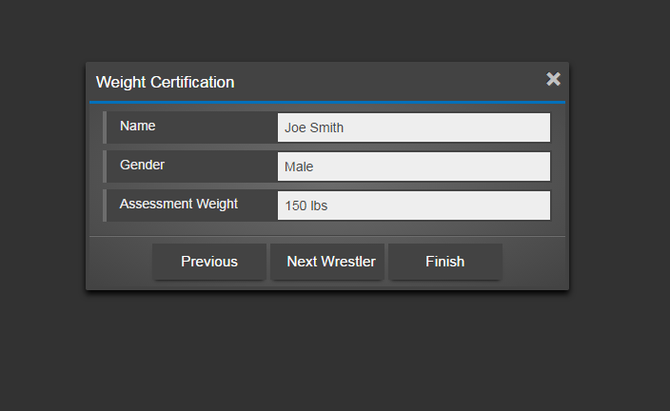
Input of Data
Entering an Assessment: Entering Assessment Instructional Video
  NOTE: After entering the measurements and clicking “Next” (at the 2:26 mark of the video), Assessors will NOT be able to view Minimum Wrestling Weight. That info will go to the coach after the assessment is Committed.
  This is the information you will see after entering measurements.
Notes:
Inputting data
You can change errors
You can change other assessor’s numbers if a General Assessor
You can do an appeal if a General Assessor
You can enter a failed hydration test
A and D

Slide 55
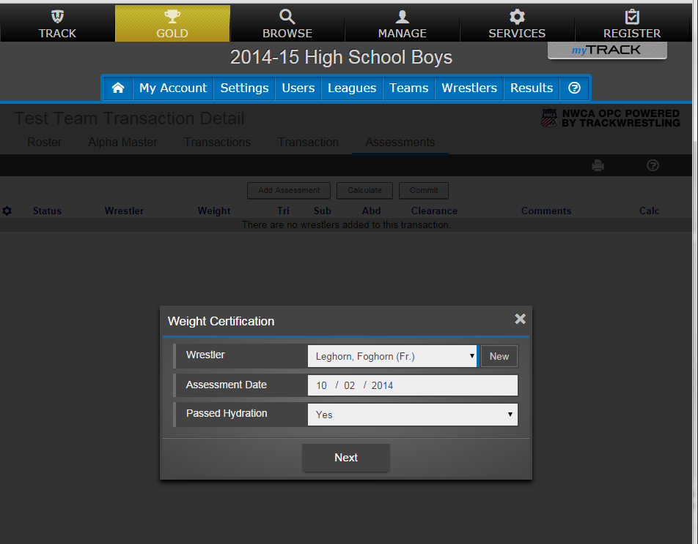
Initial Assessment – Select Wrestler

Slide 56
Initial Assessment – Input Measurements

Slide 57
Input of Data
If the wrestler is not already entered into the system prior to assessment, enter the following information from the Individual Profile Form.
  Name of Student-Athlete: (Last name, first name)
  Wrestler’s grade (9-12)
  Alpha Date (Enter date of assessment)
  Urine Specific Gravity (Click on “Pass”. If the specific gravity is 1.026 or above, click “No” and do not proceed any further. The wrestler may not be assessed for 48 hours).
  Must enter if they failed hydration testing along with alpha date

Slide 58
Input of Data
Continue to enter the following information from the Individual Profile Form if passed hydration test.
  Alpha Body Weight (must be verified by entering it twice)
  Skin-Fold Measurements
    Enter the raw data from the skinfold caliper measurements.

Slide 59
Record Keeping Original Assessment
Must have parent permission form to input athlete’s data
Keep parent permission form with individual profile
Keep forms for 1 year
If athlete needs to appeal or redo hydration testing, a copy of the original individual profile is to accompany the athlete or be sent to the Assessor conducting the appeal.
Master Assessor can request a copy from General Assessor
  Individual profile must have the original assessors name and contact number on actual paper work
  Compare to measurements in Trackwrestling
Notes:
Record Keeping
a. Keep forms for 1 year
b. Keep parent permission form with individual profile form
c. Athlete needs original profile form for a failed hydration test or appeal with assessors name and phone number
d. All the above

Slide 60
If the Athlete Relocates…
If athlete switches schools after the original assessment
  Contact Tyler Brooks with the OHSAA to get wrestler information transferred to new school

Slide 61
Appeal Process

Slide 62
Appeal Process for Body Composition Assessment
If the wrestler is dissatisfied with his or her body fat measurement they shall be given the opportunity to appeal their results.
When a master assessor enters appeal data, they must indicate it using the appeal link. Failure to do so may disqualify results.

Slide 63
Appeal Process for Body Composition Assessment
All steps shall occur within 14 calendar days of the original Alpha Date with day one being the day after the Alpha Date.
The 1.5% weight loss per week rule is in effect following the Alpha Date.
  This means that in Week 1 (days 1-7 of the appeal window), the wrestler is permitted to lose between 0-1.5% of their body weight and still be eligible for an appeal.
  In Week 2 (days 8-14), the wrestler is permitted to lose an additional 1.5% of their body weight and still be eligible for an appeal.
In order to utilize the results of an appeal, the wrestler must compete at their approved lowest minimum weight during an appeal for a lower weight.
Notes:
True or False
The athlete can lose 2% body weight a week from original alpha date

Slide 64
Appeal Process for Body Composition Assessment
Two steps in appeal process (all at wrestler’s cost):
  Step 1 - Master assessor in area will retest the athlete per testing guidelines within 14 days using skinfold calipers.
    Must have a parent permission form for appeal
  Only appealing body composition NOT weight. Must follow 1.5% loss of body weight each week.
  Step 2 - Either hydrostatic weighing or air displacement (BODPOD GS) may be used for the appeal process.
    Results of this test are automatically accepted, no further appeal is permitted.
    Refer to OHSAA website for approved sites for testing.
  A wrestler can opt to start at either step.

Slide 65
Hydrostatic Weighing for Appeal Process
Notes:
How can an athlete appeal
Bod Pod
Hydrostatic weighing
Skinfold via Master Assessor
All the above

Slide 66
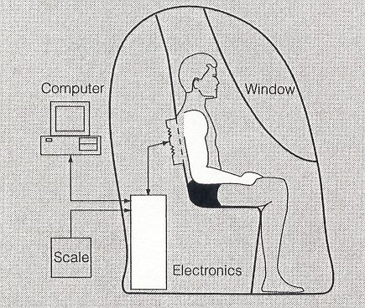
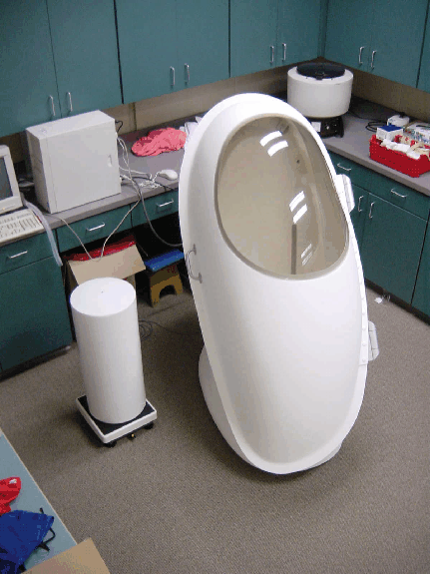
Air Displacement Plethysmography (BOD POD) for Appeal Process.

Slide 67
Appeal Process for Body Composition Assessment
All appeals and assessments must be completed by January 15, 2016
Hydrostatic Weighing or Air Displacement assessment facilities must be approved by the OHSAA and the appeal proposal must be submitted to the OHSAA before any assessment occurs.

Slide 68
Appeal Process for Body Composition Assessment
Penalty: A wrestler who weighs in at a weight before the proper amount of time has passed to achieve the lowest minimum weight, will be considered an ineligible wrestler and subject to OHSAA regulations and sanctions.
A wrestler may compete before or during an appeal only at his or her lowest allowable weight based on the initial assessment.

Slide 69
Costs

Slide 70
Costs
All costs incurred for the initial assessment and appeal process are the responsibility of the school or parent.
An assessor may charge up to $5.00 per athlete for each assessment plus $35.00 per hour. This charge is assessed for any athlete who passes or fails the urine specific gravity test.

Slide 71
Costs
An athlete who appeals the initial test will be charged $10.00 for a body fat assessment using skinfold calipers.
In addition to the $35 per hour charge for services and the $5 per assessment (not exceeding $55.00), OHSAA assessors are permitted to charge mileage at the IRS standard rate whenever travel is required to an assessment location.
Second option—Bod Pod
  Must be Bod Pod GS model
  Site approved by OHSAA
  Charge up to $75

Slide 72
Costs
CLIA lab certification will be obtained by the OHSAA and all assessors will work under that certificate
The school’s cost for membership in the NWCA is $30.00 and this allows each school access to the Optimal Performance Calculator via Trackwrestling.

Slide 73
Weight Loss Plan

Slide 74
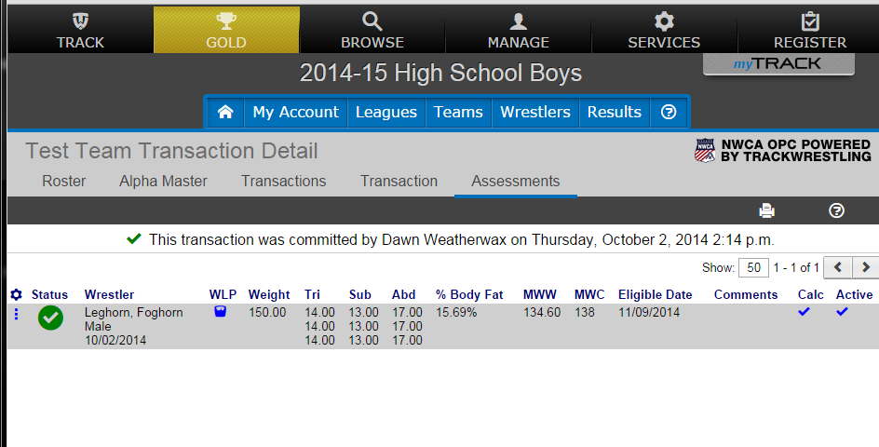
Weight Loss Plan (WLP)
The Weight Loss Plan for a Wrestler is able to be viewed from My Account -> My Transactions -> then select a transaction
After selecting a transaction then click the little blue symbol by the wrestler’s name to view the WLP.

Slide 75
Summary (1 of 2)
Done in pen
Assessor who did failed hydration test or skinfold signs individual profile form
Keep paper work for 1 year
Cannot test or retest your own athlete if they fail the hydration test except master assessor
Can use other brands of specific gravity strips
Can charge up to $40 for retest
Must put in failed hydration test immediately in computer/same day
Scale: Digital, measured to the tenth
Skinfold--Measure until you get 3 tests within a mm

Slide 76
Summary (2 of 2)
Cannot change an original wrestling assessor's numbers.
    Double check numbers before you save
    Any incorrect numbers that are in a committed transaction can only be changed by Tyler Brooks.
    Copy of Individual Profile will need to be provided to Master Assessor in the event of an appeal
    Coaches can make name changes and should have roster in computer prior to original test date.
Any ethics that are violated will be reported to OHSAA and the professionals organization
Must report change of email/phone number to Tyler Brooks at the OHSAA
Coaches role: put in roster on Trackwrestling prior to testing

Slide 77

Thank you for your participation in the
OHSAA Wrestling Weight Management Program!

